Slide 1

IDENTIFY HEIGHT WEIGHT AND BMI OF AN IMAGE WITH THE HELP OF MACHINE LEARNING
GROUP MEMBERS NAME
NAILA HASHMI (16)
JYOTI SHANKAR KAWAR (25)
SHWETA SHANKAR KAWAR (26)
PROJECT GUIDE
PROF. SARITA KHEDIKAR
Notes:
Image source:-
https://pixabay.com/en/computer-keyboard-apple-laptop-2563737/

Slide 2
01
PROBLEM STATEMENT
1
02
OBJECTIVES AND SCOPE OF THE PROJECT
2
03
SYSTEM REQUIREMENTS
3
04
LITERATURE CITATIONS
4
05
6
PROJECT PLANNING
06
ARCHITECTURE FLOWCHART
7-10
07
ALGORITHM DEVELOPMENT
11-12
08
IMPLEMENTATION /SNAPSHOTS OF OUTPUT
17
09
CONCLUSION
13

Slide 3
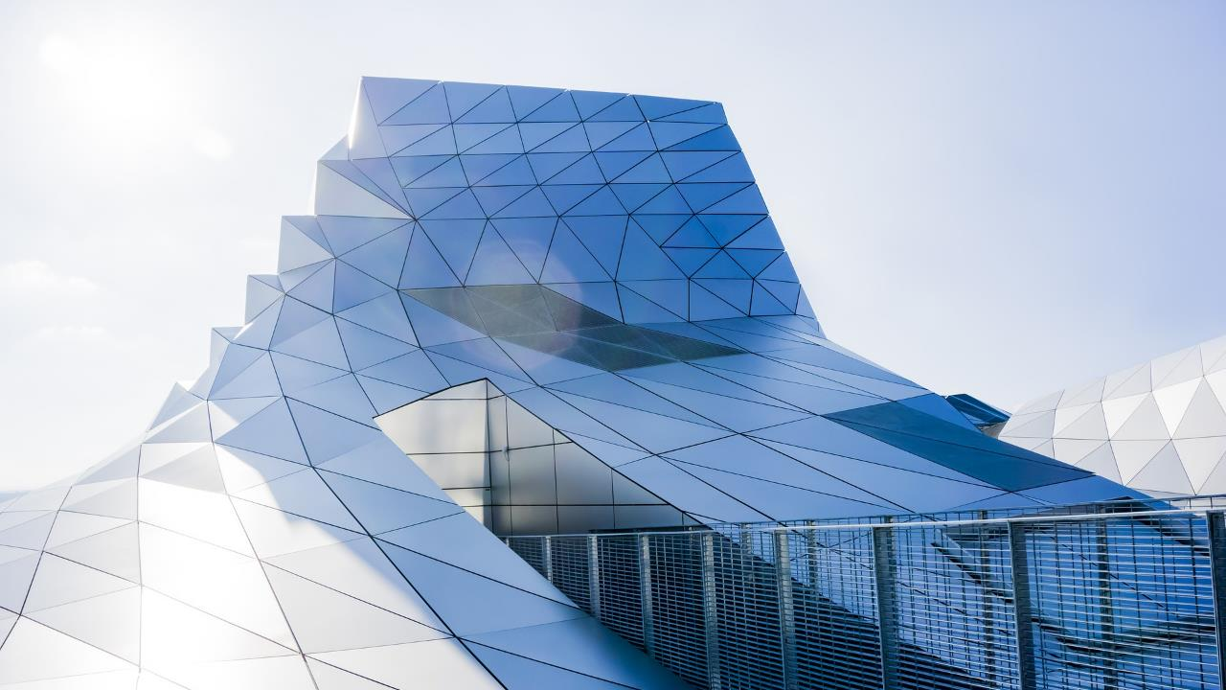
PROBLEM STATEMENT
01
IN THIS PROJECT OUR MAIN AIM IS TO ESTIMATE HEIGHT AND WEIGHT OF THE PERSON BY HAVING PHOTOGRAPH AS AN INPUT USING MACHINE LEARNING CONCEPTS.
BY CALCULATING THE HEIGHT AND WEIGHT OF THE PERSON FROM AN IMAGE WE PROVIDE THE ANALYSIS OF BODY MASS INDEX (BMI).
WE ALSO SHOW HOW COMPUTER VISION CAN BE USED TO INFER A PERSONS BMI FROM SOCIAL MEDIA IMAGES. WE HOPE THAT OUR TOOL, WHICH WE HAVE CREATED HELPS TO STUDY THE SOCIAL ASPECTS RELATED TO THE BODY WEIGHT.
Notes:
Image source:-
https://pixabay.com/en/architecture-building-business-2179108/

Slide 4
OBJECTIVES AND SCOPE OF THE PROJECT
THE MAIN AIM IS TO MAKE SYSTEM, THAT MEASURES YOUR HEIGHT AND WEIGHT FROM AN IMAGE USING MACHINE LEARNING
ESTIMATE THE BMI OF A PERSON.
SCOPE OF THE PROJECT :
A PERSONS WEIGHT CAN HAVE PROFOUND IMPLICATIONS ON THEIR LIFE, RANGING FROM MENTAL HEALTH TO FINANCIAL INCOME.
AT THE SOCIAL LEVEL “FAT SHAMING” AND OTHER FORMS OF “SIZEISM” ARE A GROWING CONCERN, WHILE INCREASING OBESITY RATES ARE LINKES TO EVER RAISING HEALTHCARE COSTS.
FOR THSESE REASONS, TO OBTAIN DATA, TRADITIONALLY, A PERSON WOULD HAVE TO ACCURATELY SELF-REPORT THEIR BMI OR WOULD HAVE TO SEE A DOCTOR TO HAVE IT MEASURED

Slide 5
SYSTEM REQUIREMENT:
SOFTWARE REQUIREMENTS:
JUPYTER NOTEBOOK(ANACONDA)
GOOGLE COLAB
HARDWARE REQUIREMENT
OPERATING SYSTEM: WINDOWS, LINUX
3

Slide 6
LITERATURE CITATIONS 1.A. Dantcheva, F. Bremond and P. Bilinski, "Show me your face and I will tell you your height, weight and body mass index," 2018 24th International Conference on Pattern Recognition (ICPR), 2018, pp. 3555-3560, doi: 10.1109/ICPR.2018.8546159. 2.Enes Kocabey∗vi, Mustaf Camurcu†, Ferda Ofli‡,Yusuf Aytar∗, Javier Marin∗,Antonio Torralba∗, Ingmar Weber "Face-to-BMI: Using Computer Vision to Infer Body Mass Index on Social Media∗" arXiv:1703.03156v1 [cs.HC] 9 Mar 2017 3.Omkar M. Parkhi omkar@robots.ox.ac.uk Andrea Vedaldi vedaldi@robots.ox.ac.uk Andrew Zisserman az@robots.ox.ac.uk, "Deep Face Recognition" Visual Geometry Group Department of Engineering Science University of Oxford

Slide 7
PROJECT PLANNING Project Model Adopted: PROTOTYPE MODEL Feasibility Analysis: OPERATIONAL FEASIBILITY

Slide 8
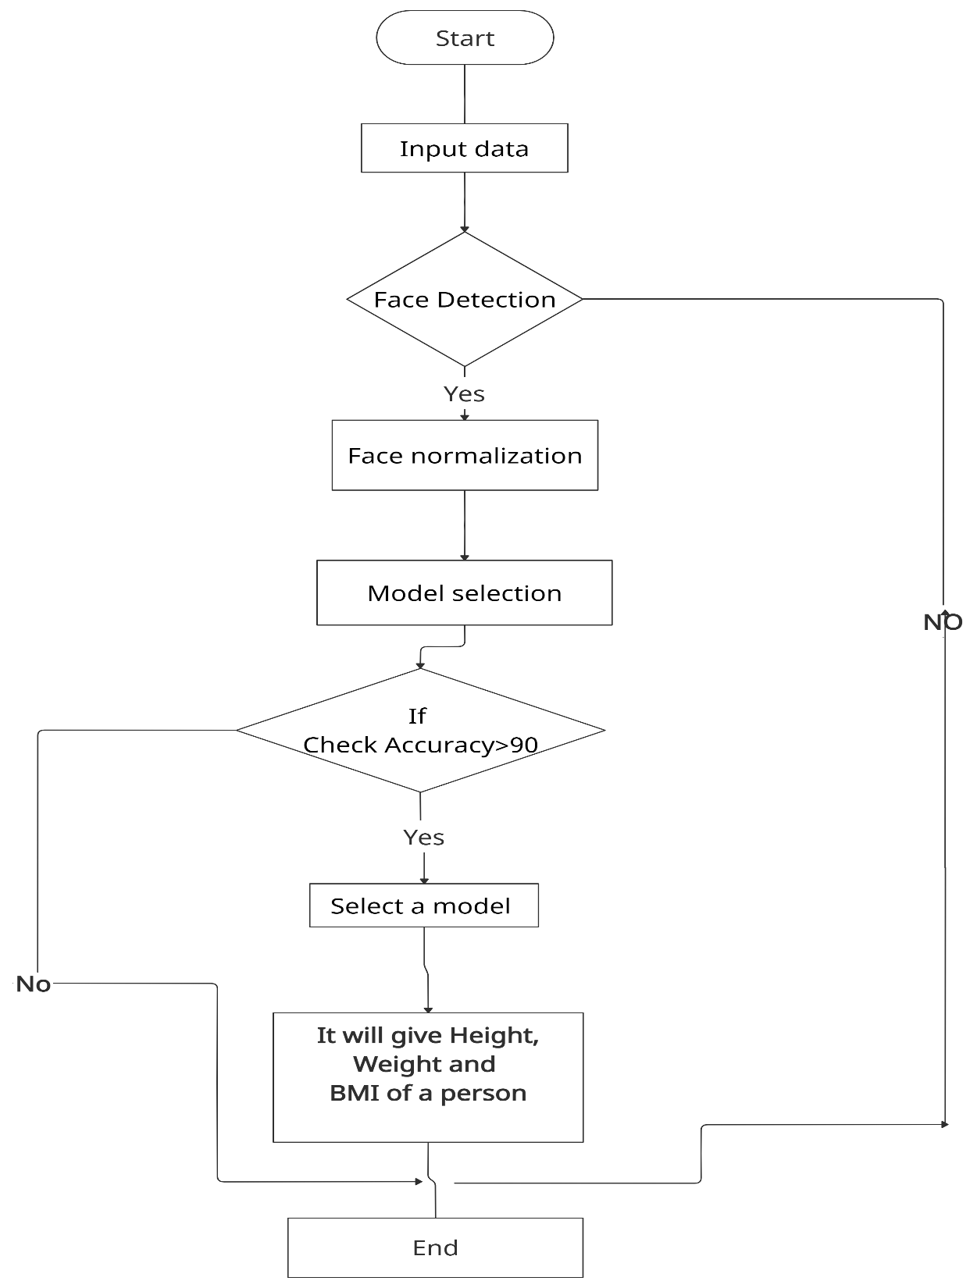
SYSTEM FLOWCHART

Slide 9
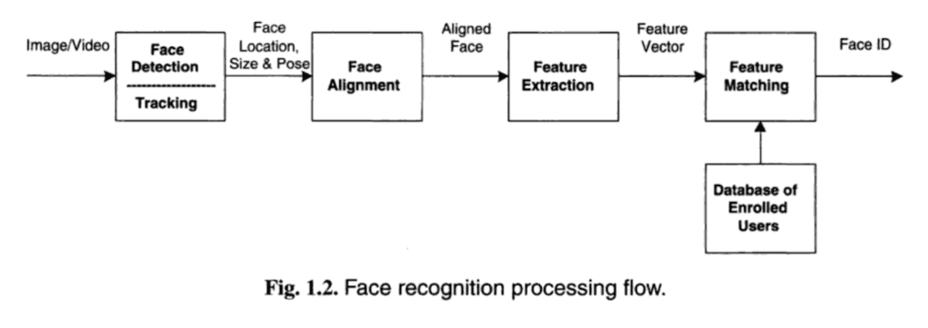
ALGORITHM DEVELOPMENT
FACENET PRETRAINED ARCHITECTURE
FACE RECOGNITION IS THE PROBLEM OF IDENTIFYING AND VERIFYING PEOPLE IN A PHOTOGRAPHY BY THEIR FACE.
FOR FACE RECOGNITION WE HAVE USED THIS FACENET PRETRAINED ARCHITECTURE MODEL THAT DIRECTLY LEARNS A MAPPING FROM FACE IMAGES TO COMPACT EUCLIDEAN SPACE WHERE DISTACE DIRECTLY CORRESPONDS TO A MEASURE OF FACE SIMILARITY.

Slide 10

Metric to check the goodness of fit
We have used this statistical technique to see how well the actual data points fit into machine learning models.
It summarizes the process between actual observed data points and expected data points in context to a statistical or machine learning model
We have compared few regression model and select one with better score.
Linear regression
Ridge regression
Random Forest Regression
Kernel Ridge Regression

Slide 11
To compare above regression models we use HYPERPARAMETER TUNNING Hyper parameter allows us to choose the correct parameter to get the best accuracy score for a model Here we performed RANDOM SEARCH ALGORITHM And we get the 1. mean variance error 2.variance score Model performance 1.average error 2.accuracy
7

Slide 12
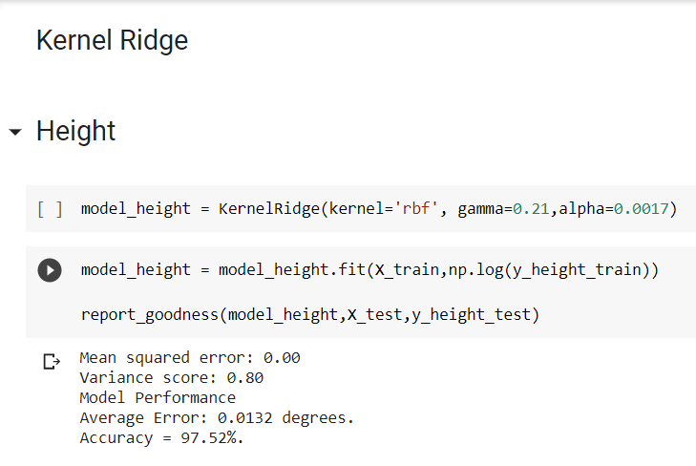
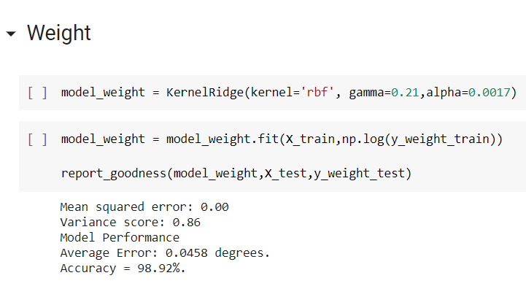
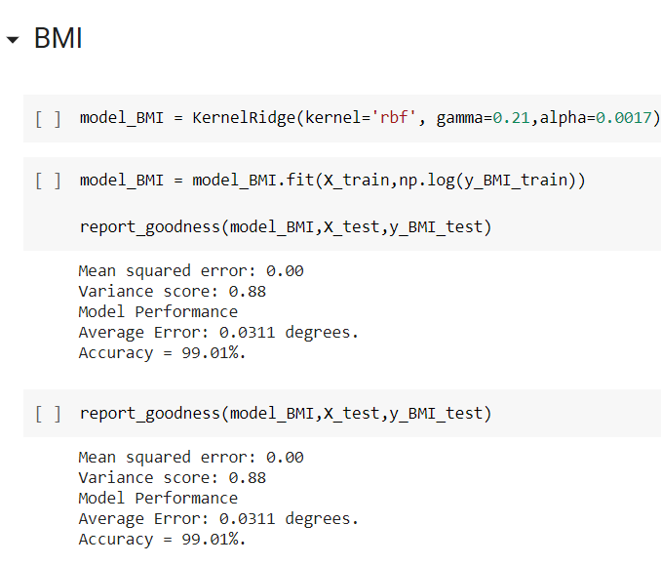
We found that kernelized Ridge regression outperformed all the models in terms of the mean squared error and explained variance
8

Slide 13
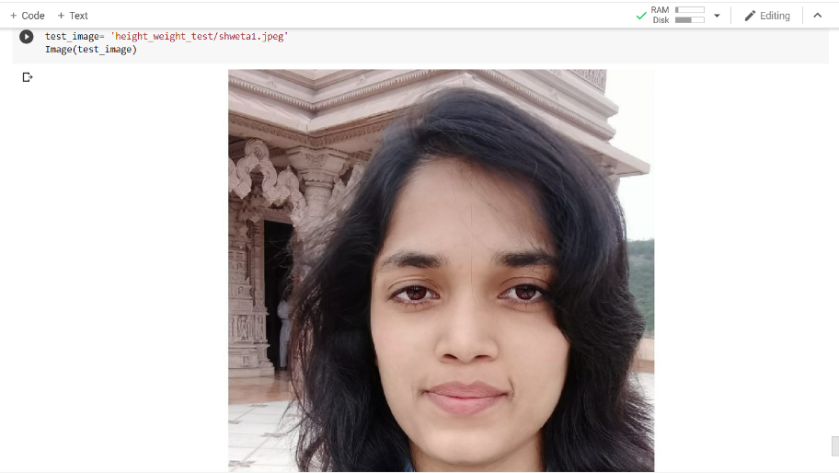
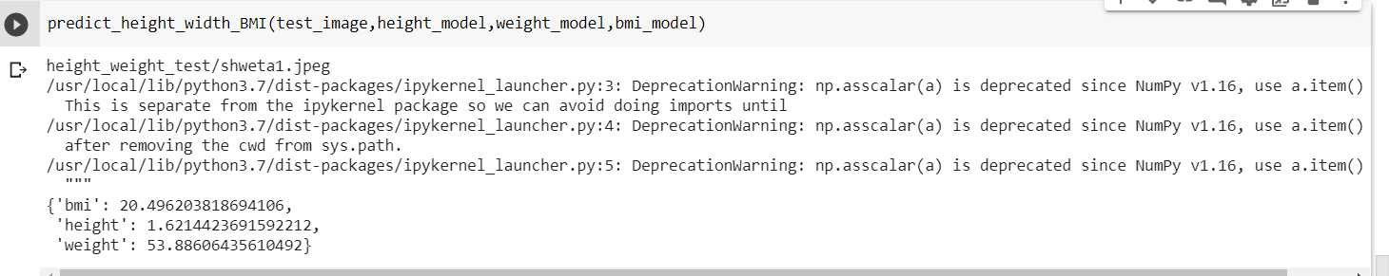
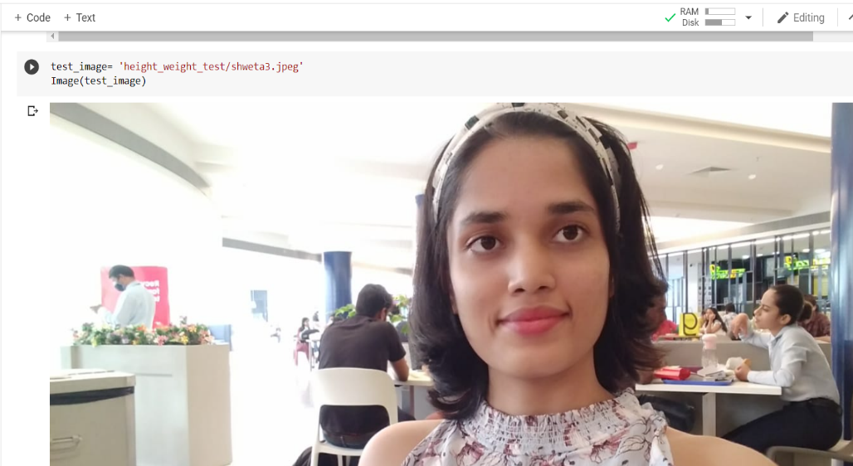
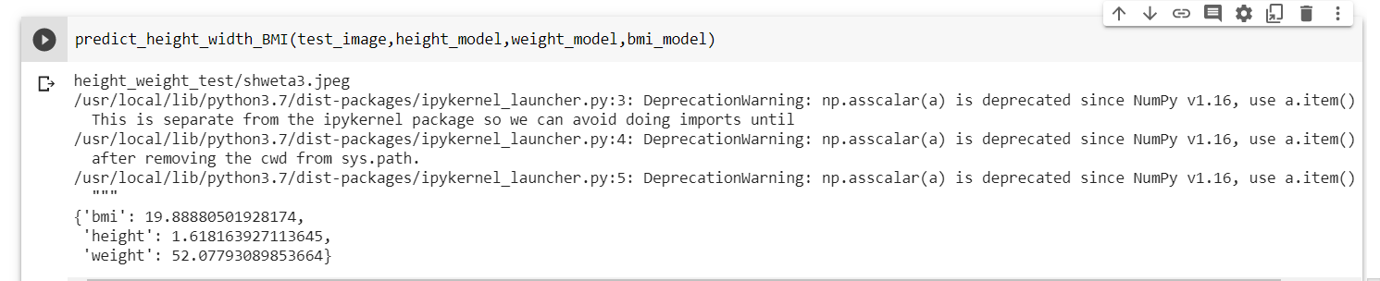
Results/ output snapshots

Slide 14
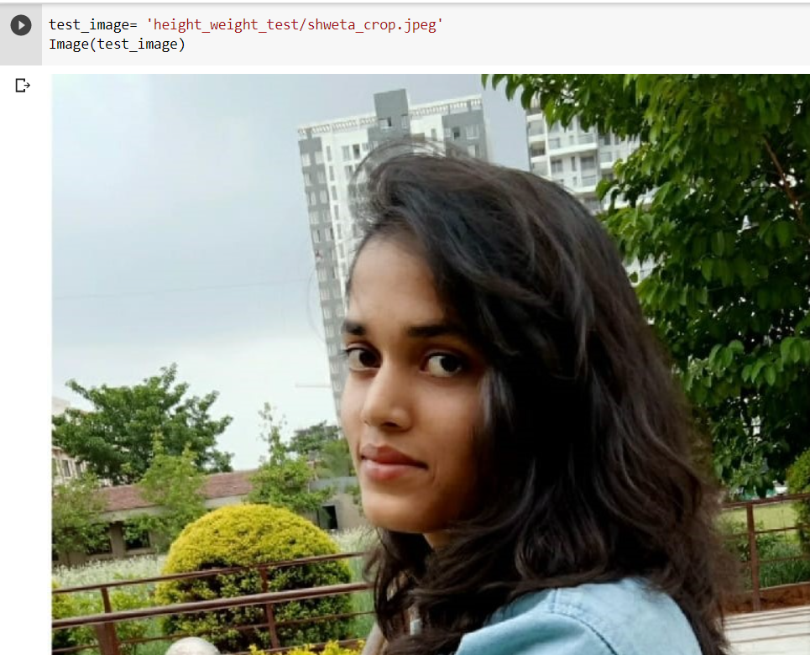
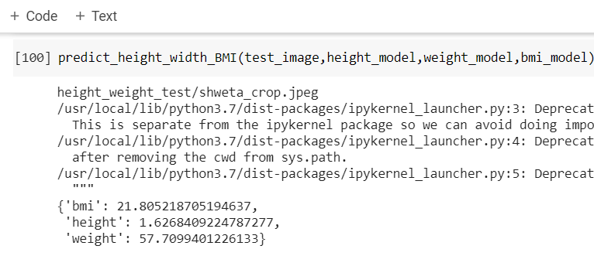
We have added 3 different photographs of a same person and checked the accuracy of a project. It shows more accuracy in front view photographs as compared to the other view photographs.

Slide 15
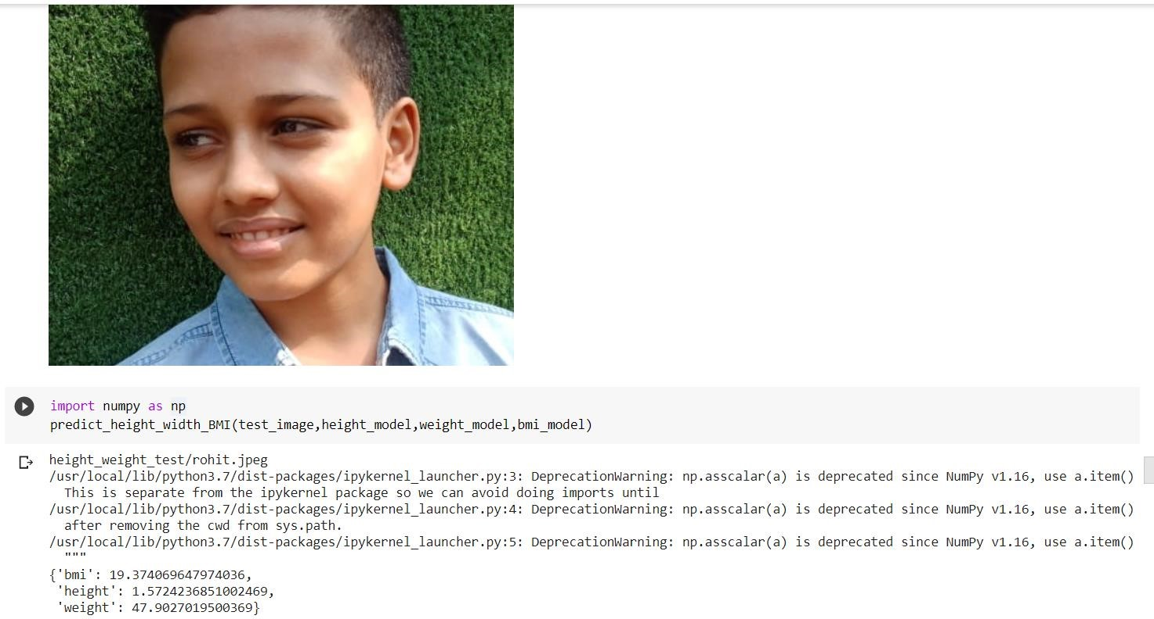
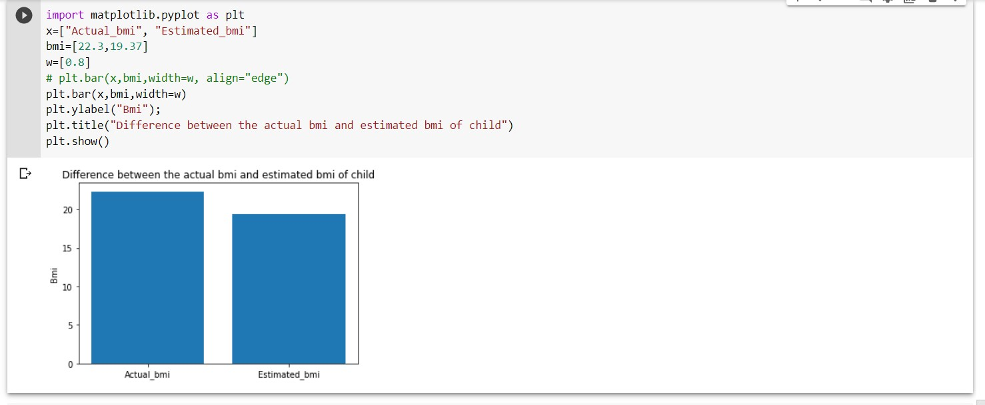
Estimation of height weight of a person from 10 to 12 age group
Accuracy of the model in the case of a child has less than the normal person. It shows quite a difference in weight and height remains the same.

Slide 16
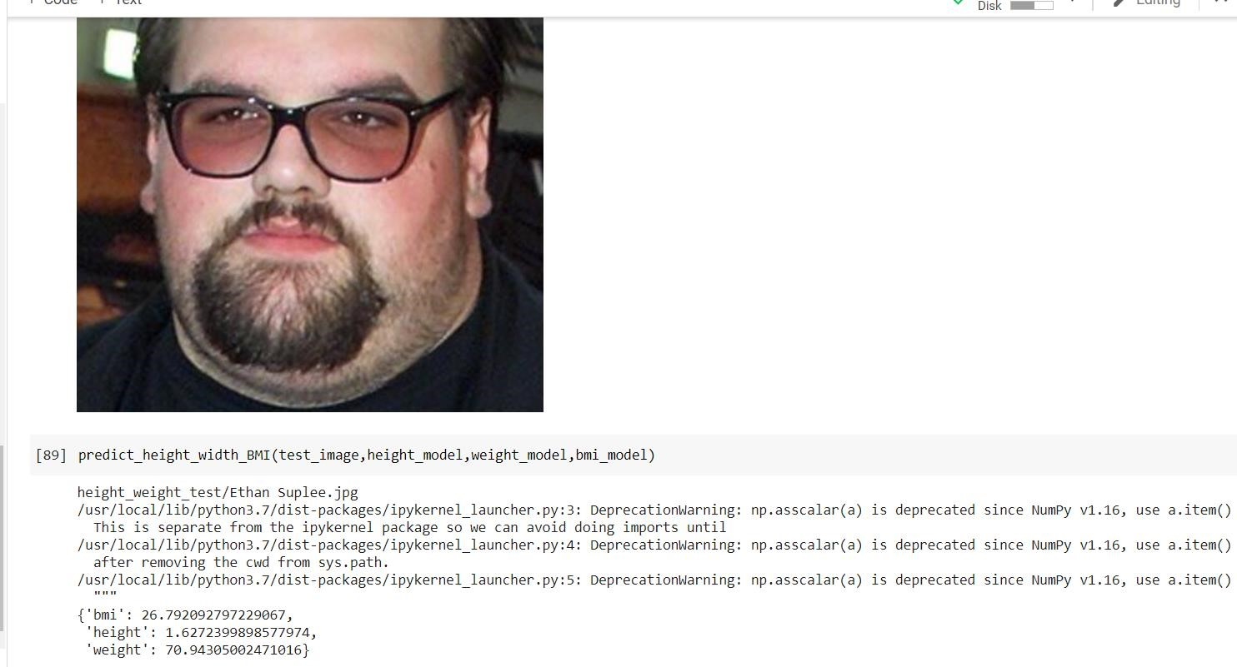
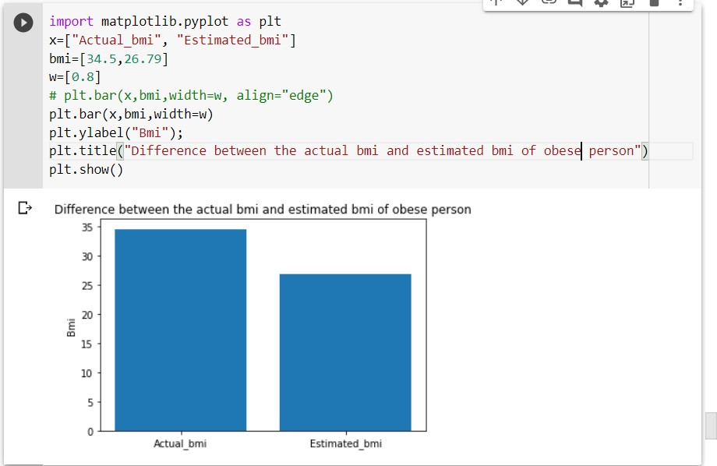
Estimation of height weight of obese person

Slide 17
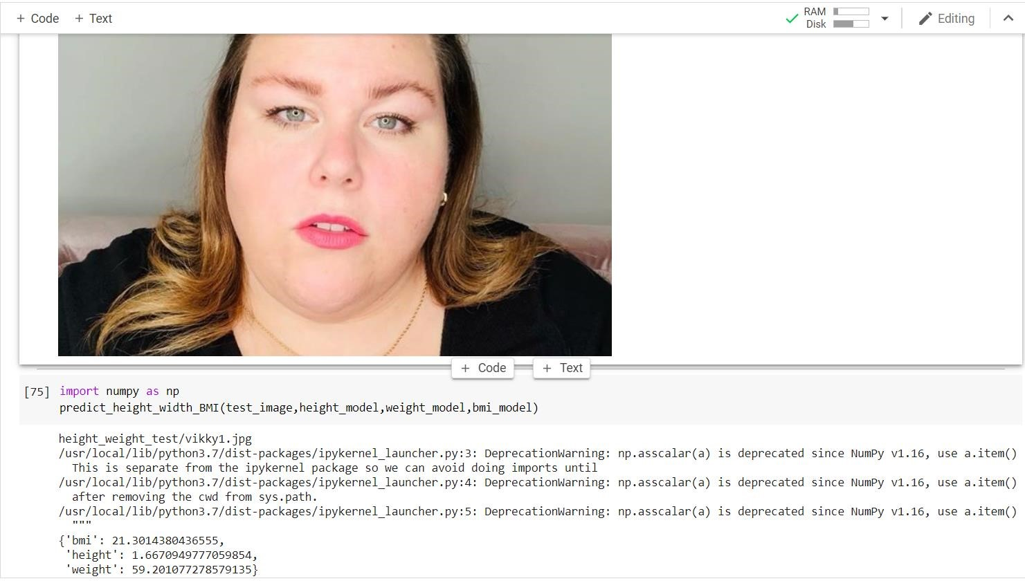
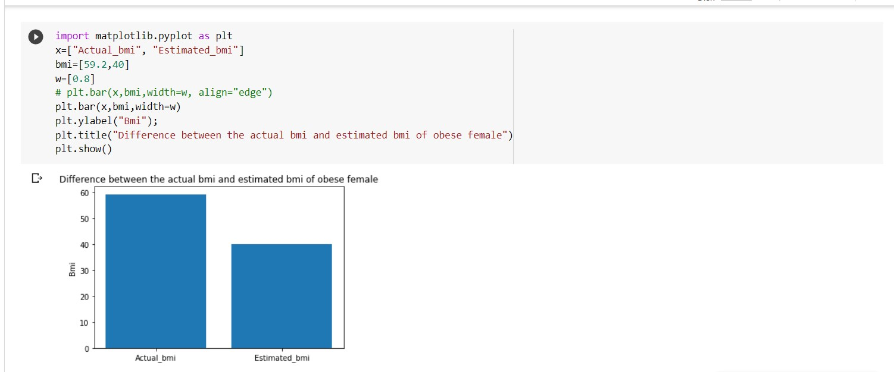
There is large difference in the actual bmi and estimated bmi of obese person. Accuracy of this model for the obese person is less in this case

Slide 18
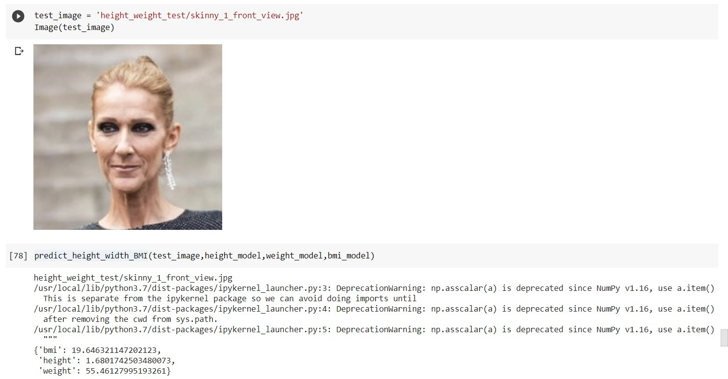
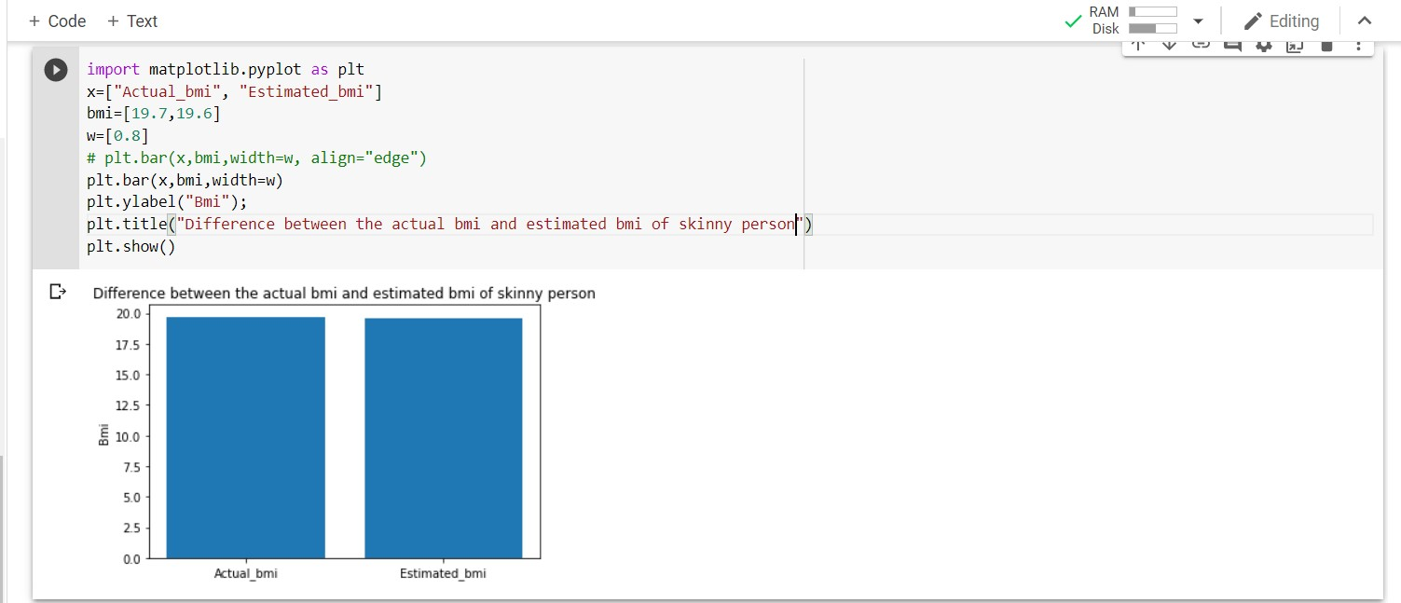
Estimation of height weight of skinny person

Slide 19
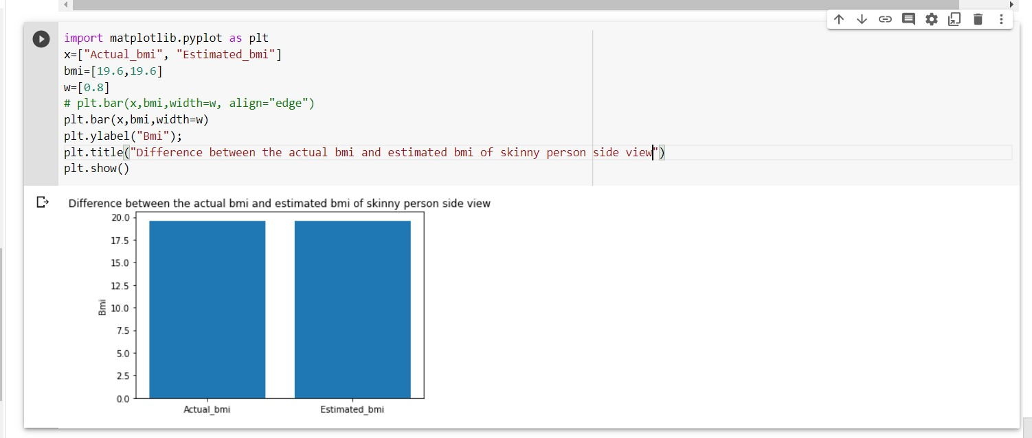
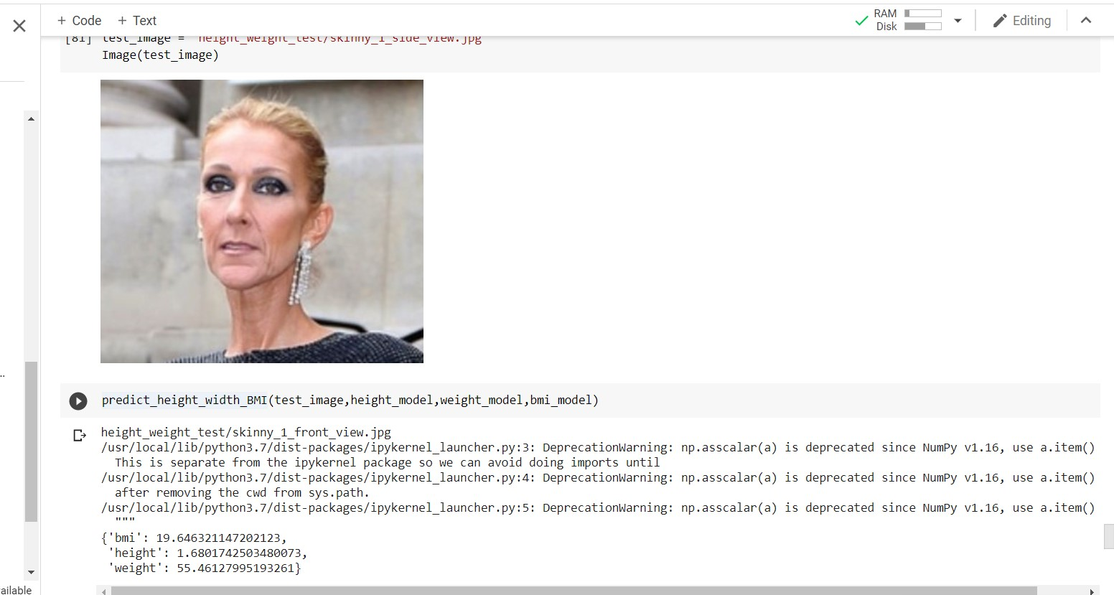
Side view
• There is a small difference in the actual bmi and estimated bmi of a skinny person. Accuracy of this model for the skinny person is good.

Slide 20
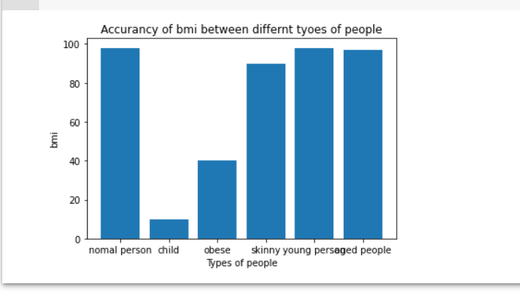
Graphical representation of accuracy in bmi between all types of people

Slide 21

CONCLUSION
With the help of computer vision and facenet architecture we have predicted the height, weight and body mass index(bmi) of a person.
In this work, we apply the most recent computer vision techniques to obtain a novel face-to-bmi system.
22
Notes:
Image source:-
https://pixabay.com/en/coding-programming-working-macbook-924920/

Slide 22
Thank You
Notes:
Image source:-
https://pixabay.com/en/coding-programming-working-macbook-924920/

